Slide 1
MOPPA: sprint 3
Tests

Slide 2
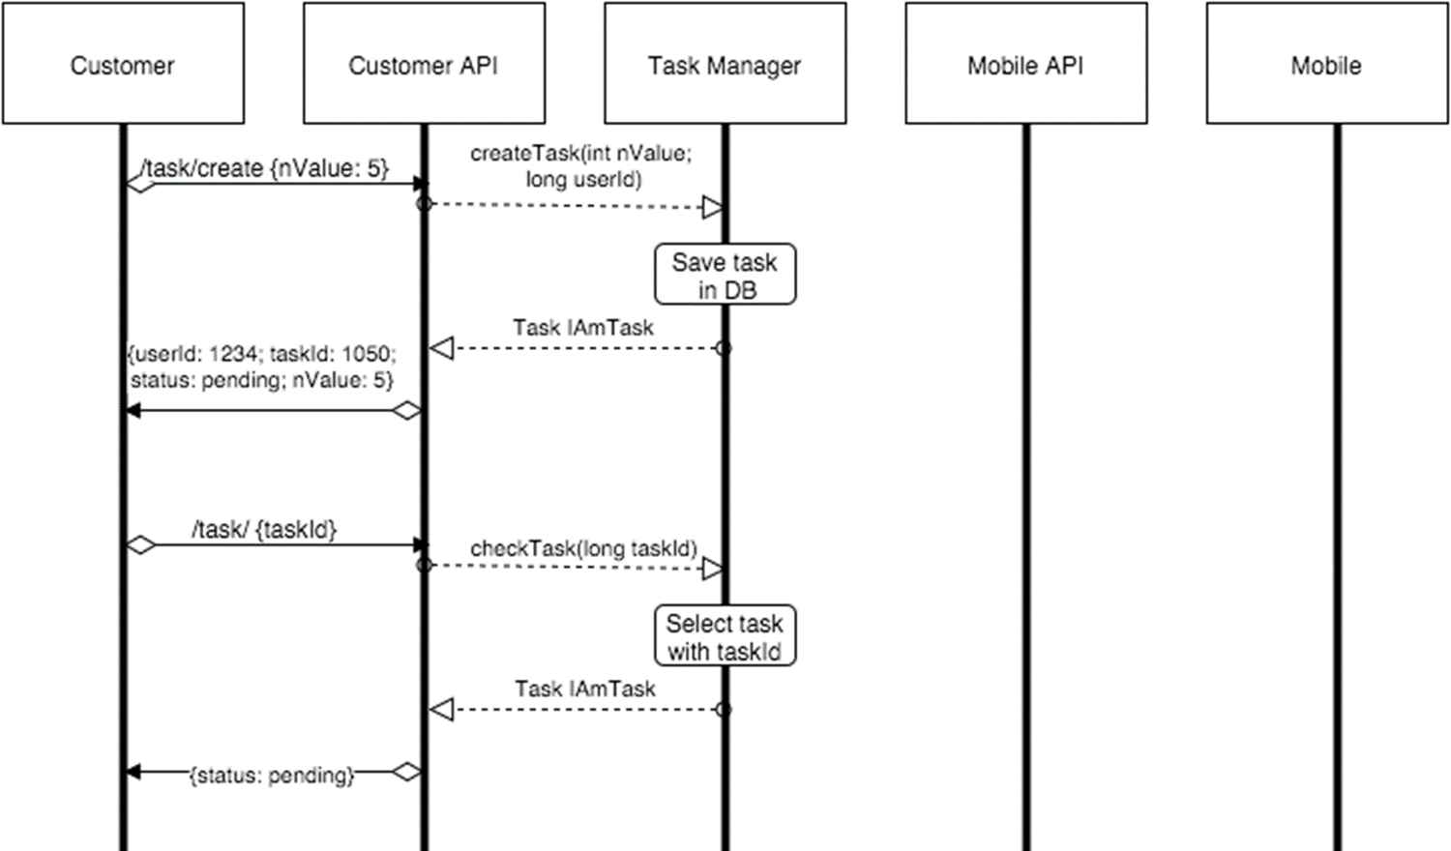
Working model
Notes:
After eacyper of us developed part of API (customer and mobile part), we decide that it is time to make a project model together with the aim of connection between two parts and reach an agreement about terms, classes, how we will develop new sprints e.t.c.

Slide 3
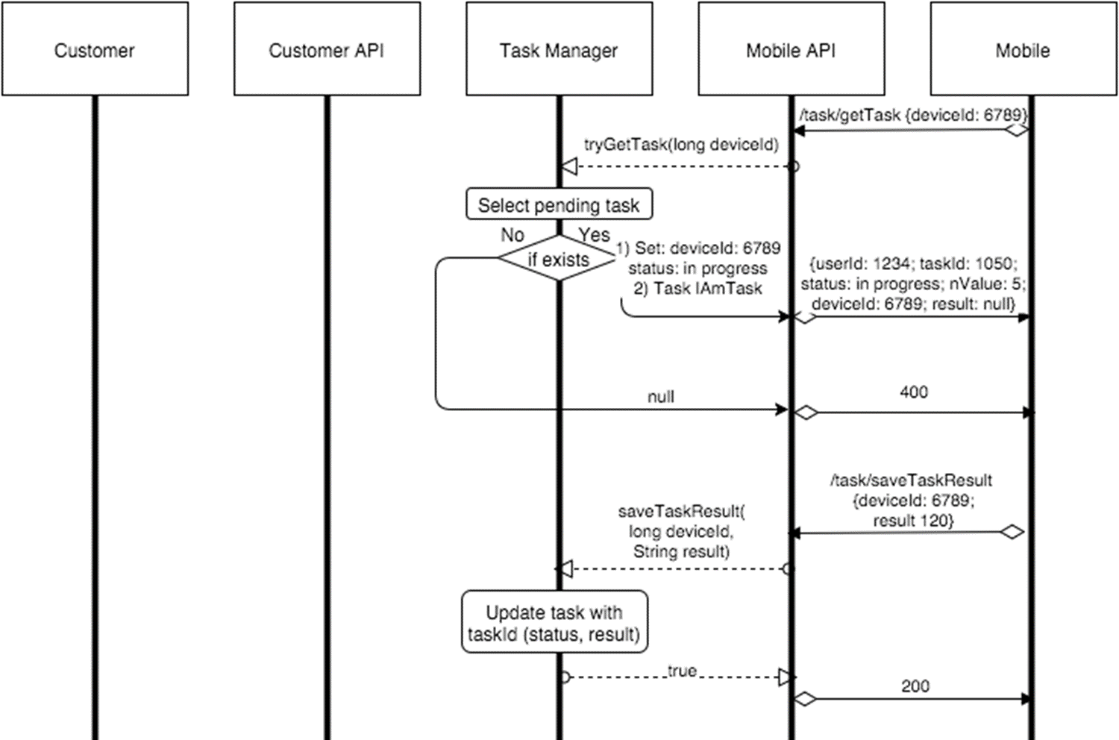

Slide 4
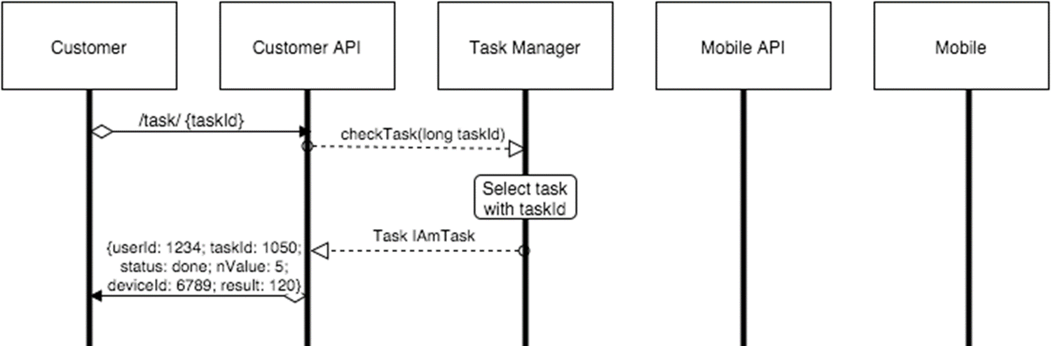

Slide 5

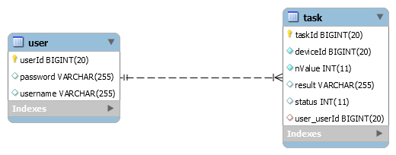
Database schema

Slide 6
Test cases

Slide 7
Equivalent classes retriveTask(long deviceId)
Variable | Valid equivalence classes​ | Values for valid ECs | Boundary values | Invalid ECs | Values for invalid ECs
deviceId in task | Long, which is more than zero | 100500 | 1 | Long, which is less than zero | -100500
 |  |  |  | Any alpha-numeric value (not long) | arm1

Slide 8
Equivalent classes saveResultTask(long deviceId, String result)
Variable | Valid equivalence classes​ | Values for valid ECs | Boundary values | Invalid ECs | Values for invalid ECs
deviceId in task | Long, which is more than zero | 100500 | 1 | Long, which is less than zero | -100500
 |  |  |  | Any alpha-numeric value (not long) | arm1
result | String with numeral symbols | "12312321321321" |  | String with whitespaces and not numeral symbols | “W12 tr453”
 |  |  |  | Not String type | 123

Slide 9
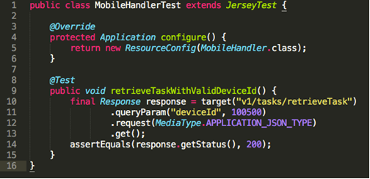

Slide 10
Equivalent classes – Get task getTask(@ApiParam(value = "Id of the task") @PathParam("taskId") long taskId)
Variable | Valid equivalence classes | Values for valid ECs | Boundary values | Invalid ECs | Values for invalid ECs
taskId | Existing ids | 2 | 1 | Not existing ids | 1500
 |  |  |  | Any alpha-numeric value (not integer) | 1abc

Slide 11
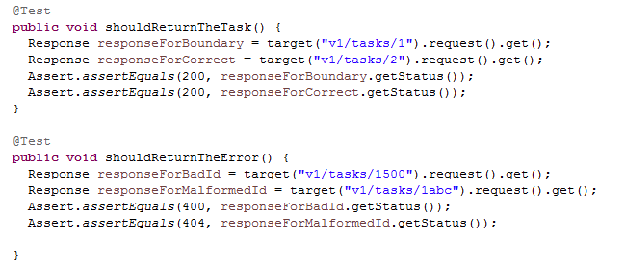
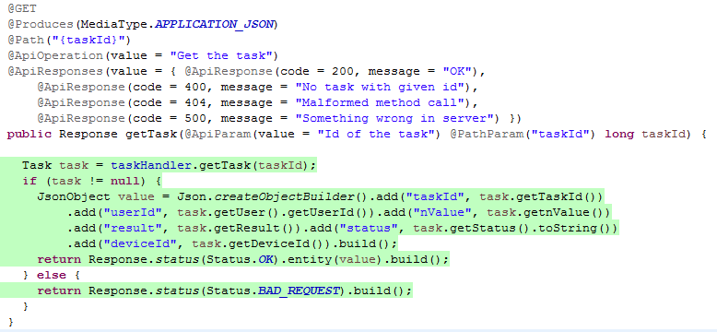

Slide 12
Equivalent classes – Create task createTask(@ApiParam(value = "Task to create on server") Task task)
Variable | Valid equivalence classes | Values for valid ECs | Boundary values | Invalid ECs | Values for invalid ECs
nValue in task | Integers from 1 to 100 | 5 | 1, 100 | Integers out of 1 to 100 range | 150
 |  |  |  |  | 1bb
userId in task | Existing ids | 1 |  | Not existing ids | 151900
 |  |  |  | Any alpha-numeric value (not long) | @@

Slide 13
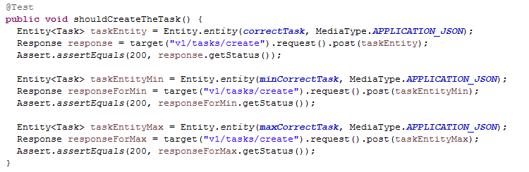
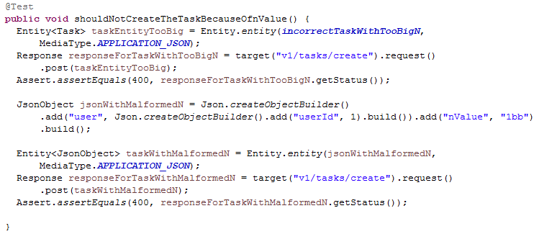

Slide 14
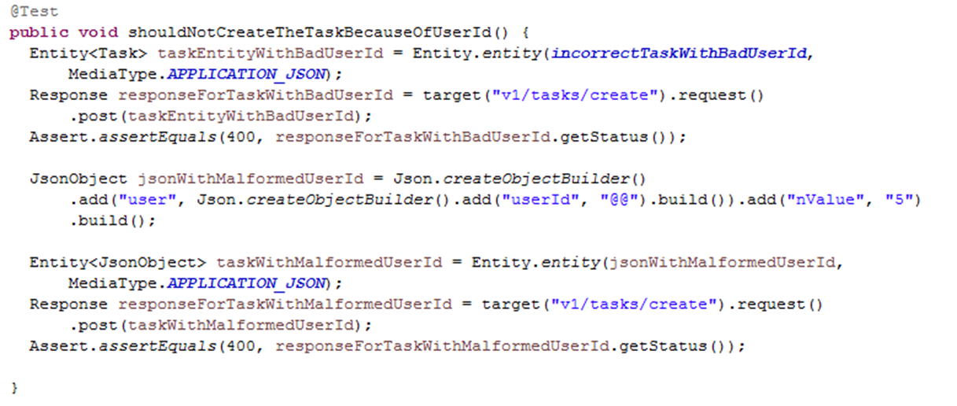

Slide 15
Equivalent classes – Get all the tasks for user getUserTasks(@ApiParam(value = "ID of the user") @PathParam("userId") long userId)
Variable | Valid equivalence classes | Values for valid ECs | Boundary values | Invalid ECs | Values for invalid ECs
userId in task | Existing ids | 1 |  | Not existing ids | 2222222
 |  |  |  | Any alpha-numeric value (not long) | !@&

Slide 16
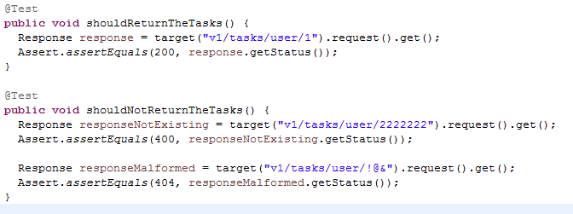

Slide 17
Equivalent classes – Login login(@ApiParam(value = „User data") User user)
Variable | Valid equivalence classes | Values for valid ECs | Invalid ECs | Values for invalid ECs
username & password in User | Existing username & password pair | {goodUser, goodPass} | Invalid username & password | {randomName, randomPass}
 |  |  | Invalid username & valid password | {randomName, goodPass}
 |  |  | Valid username & invalid password | {goodUser, randomPass}

Slide 18
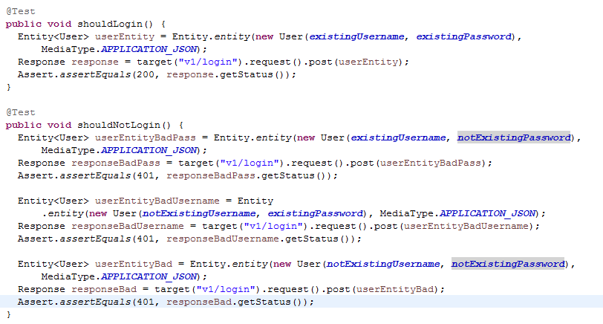

Slide 19
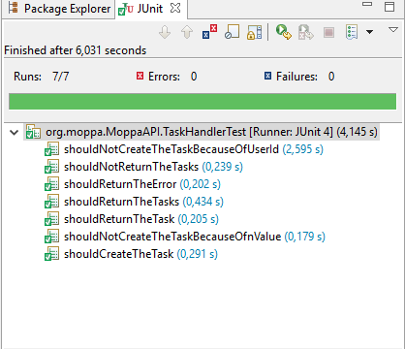
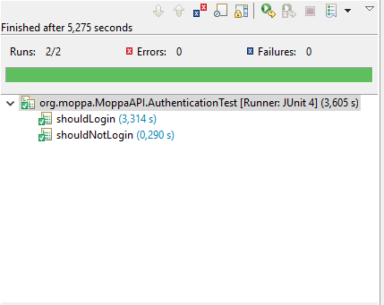

Slide 20
Eclemma and metrics

Slide 21
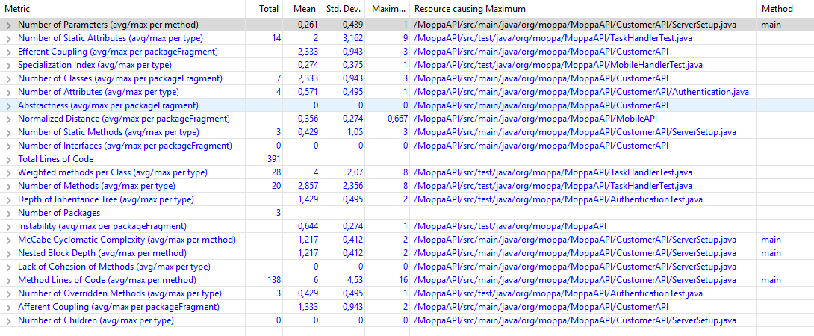
Metrics
McCabe Complexity = 1,217

Slide 22
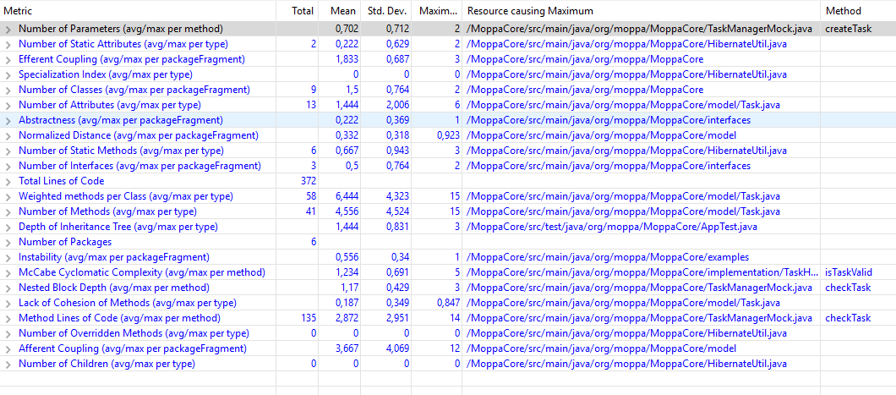
McCabe Complexity = 1,234

Slide 23
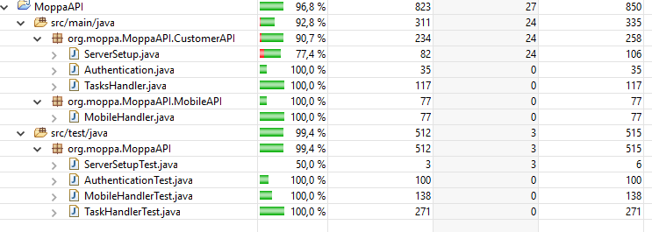

Slide 24
